Slide 1
First Grade Benchmark 1 Boot Camp Class

Slide 2
Math Core Implementation
p90x

Slide 3
Math Core Benchmark 1
Operations and Algebraic Thinking
Add and subtract within 20.
5. Relate counting to addition and subtraction
(e.g., by counting on 2 to add 2).
6. Add and subtract within 20, demonstrating fluency for addition and
subtraction within 10. Use strategies such as counting on; making ten
(e.g., 8 + 6 = 8 + 2 + 4 = 10 + 4 = 14); decomposing a number leading to a
ten (e.g., 13 – 4 = 13 – 3 – 1 = 10 – 1 = 9); using the relationship between
addition and subtraction (e.g., knowing that 8 + 4 = 12, one knows 12 – 8 =
4); and creating equivalent but easier or known sums (e.g., adding 6 + 7 by
creating the known equivalent 6 + 6 + 1 = 12 + 1 = 13).

Slide 4
Routines
• Number Parade
• Counting Tens and Ones
• Crows in a Row
• 1-120 Chart
• Number Path
• Secret Code Cards
Math Expressions Daily Routines First Grade
Daily Routines Continued
Notes:
Frogs on a Log, Hogs in a bog, Dogs on a log, …go for a jog, smog, fog, clog; Cats in a Hat, ….splat, fat, rat; Mice and dice….eating rice; Snakes and cakes,…rakes, bake; Cheetah…quesadilla, Gorilla…sasparilla,

Slide 5
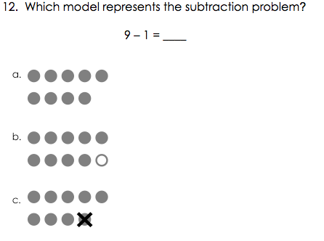
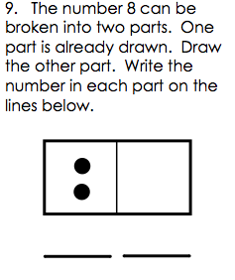
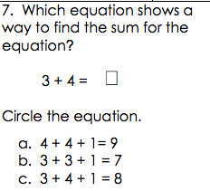
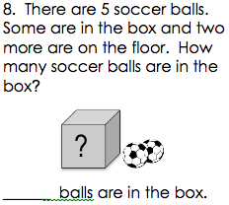
Assessment Questions

Slide 6
Operations and Algebraic Thinking Continued
Represent and solve problems involving addition and subtraction.
1. Use addition and subtraction within 20 to solve word problems involving situations of adding to, taking from, putting together, taking apart, and comparing, with unknowns in all positions, e.g., by using objects, drawings, and equations with a symbol for the unknown number to represent the problem
Understand and apply properties of operations and the relationship between addition and subtraction.
3. Apply properties of operations as strategies to add and subtract.3 Examples: If 8 + 3 = 11 is known, then 3 + 8 = 11 is also known. (Commutative property of addition.) To add 2 + 6 + 4, the second two numbers can be added to make a ten, so 2 + 6 + 4 = 2 + 10 = 12. (Associative property of addition.)

Slide 7
Building on Concepts of Cardinality (K)
Perceptual Subitizing
Conceptual Subitizing
Students can recognize a number by it’s visual representation
-fingers
-dice
-five and ten frames
Students can recognize a number and see the sub-categories within the number or the “embedded numbers”
-fingers (5 and 2)
-dice (3 and 3)
-five and ten frames
-Stair Steps
-Break Aparts
-Math Mountains
Notes:
Activities: Finger flash with the ipad. Roll a dice and match a number. Dot card flash with paper plates. Ten frames. One inch dot cards – How many do you see? Pipe cleaner numbers (break aparts)

Slide 8
Representing Number Pairs
Number Bonds
• Dominoes
• Stair Steps
• Number trains
• Break Aparts
• Math Mountains
• Ten Frames
• Partner Stories
set model for subtraction
measurement model for subtraction
Notes:
Spin and fill. Pinch a number or handy handfuls. How many more? How many fewer? (Difference of 1, 2, 3, 4,)

Slide 9
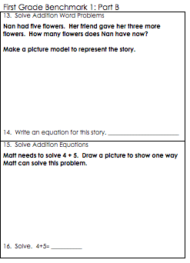
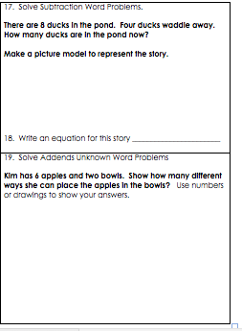
Assessments

Slide 10
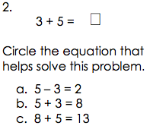

Slide 11
Operations and Algebraic Thinking
Work with addition and subtraction equations.
7. Understand the meaning of the equal sign, and determine if equations involving addition and subtraction are true or false. For example, which of the following equations are true and which are false? 6 = 6, 7 = 8 – 1, 5 + 2 = 2 + 5, 4 + 1 = 5 + 2.
8. Determine the unknown whole number in an addition or subtraction equation relating three whole numbers. For example, determine the unknown number that makes the equation true in each of the equations 8 + ? = 11, 5 = – 3, 6 + 6 = .

Slide 12
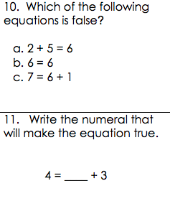
Notes:
Give the fact – tell a story, make a representation, find an answer.

