Slide 1
Second Grade Benchmark 1 Boot Camp Class

Slide 2
Math Core Implementation
p90x

Slide 3
Routines
• 1-120 Chart
• The Finger Wiggle
• The Number Path
• The Money Routine
• The Teen Machine
• Secret Code Cards
• Math Mountain Cards
• Crows in a Row (From first grade)
Math Expressions Daily Routines Second Grade
Daily Routines Continued
Notes:
Practice the routine with a partner

Slide 4
Math Core Benchmark 1
Operations and Algebraic Thinking
Represent and solve problems involving addition and subtraction.
Use addition and subtraction within 100 to solve one- and two-step word problems involving situations of adding to, taking from, putting together, taking apart, and comparing, with unknowns in all positions, e.g., by using drawings and equations with a symbol for the unknown number to represent the problem.
Add and subtract within 20.
2. Fluently add and subtract within 20 using mental strategies. By end of
Grade 2, know from memory all sums of two one-digit numbers.
Work with equal groups of objects to gain foundations for multiplication.
Determine whether a group of objects (up to 20) has an odd or even
number of members, e.g., by pairing objects or counting them by 2s;
write an equation to express an even number as a sum of two equal
addends.

Slide 5
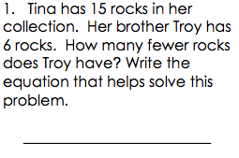
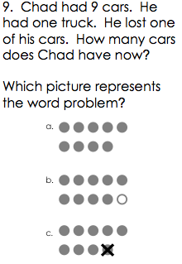
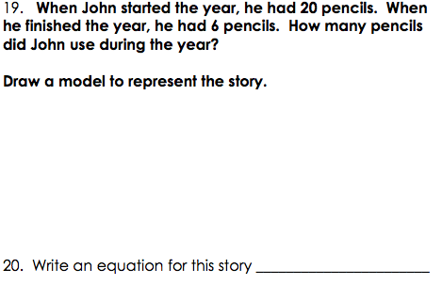
Assessment Questions OA.1

Slide 6
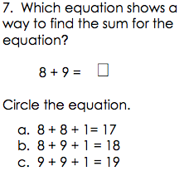
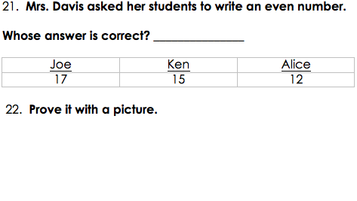
Assessment Questions OA.2 and OA.3

Slide 7
Measurement and Set Models
Compare Models
Set Model Measurement
set model for subtraction
measurement model for subtraction

Slide 8
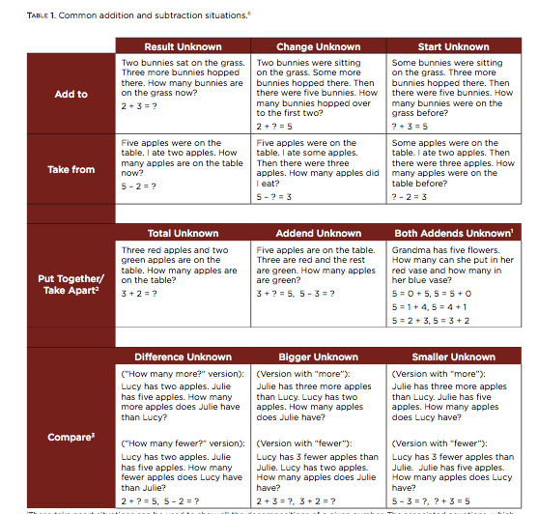
Problem Types

Slide 9
Problem Types
Add To
Take From
What is the unknown?
Change/Start/Result
Action
What is the unknown?
Change/Start/Result
Action
Put Together/Take Apart
Compare
What is the unknown?
Total/Addends/Both Addends?
No action – different parts.
What is the unknown?
Difference/Bigger/Smaller
No action – Comparison.
Notes:
Math Teen Mountain Cards, Equation Match with posters – models to represent. (Four posters and markers)

Slide 10
Numbers and Operations in Base Ten
Understand place value.
1. Understand that the three digits of a three-digit number represent amounts of hundreds, tens, and ones; e.g., 706 equals 7 hundreds, 0 tens, and 6 ones. Understand the following as special cases:
a. 100 can be thought of as a bundle of ten tens — called a “hundred.”
2. Count within 1000; skip-count by 5s, 10s, and 100s.
3. Read and write numbers to 1000 using base-ten numerals, number names, and expanded form.
4. Compare two three-digit numbers based on meanings of the hundreds, tens, and ones digits, using >, =, and < symbols to record the results of comparisons.
Use place value understanding and properties of operations to add and subtract.
5. Fluently add and subtract within 100 using strategies based on place value, properties of operations, and/or the relationship between addition and subtraction.
6. Add up to four two-digit numbers using strategies based on place value and properties of operations.
7. Add and subtract within 1000, using concrete models or drawings and strategies based on place value, properties of operations, and/or the relationship between addition and subtraction; relate the strategy to a written method. Understand that in adding or subtracting three-digit numbers, one adds or subtracts hundreds and hundreds, tens and tens, ones and ones; and sometimes it is necessary to compose or decompose tens or hundreds.
8. Mentally add 10 or 100 to a given number 100–900, and mentally subtract 10 or 100 from a given number 100–900.
9. Explain why addition and subtraction strategies work, using place value and the properties of operations.

Slide 11
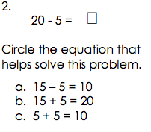
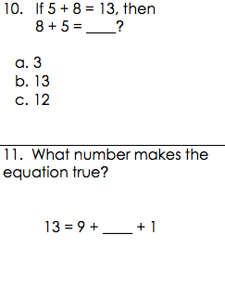
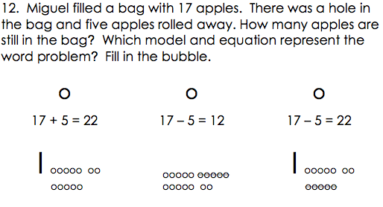
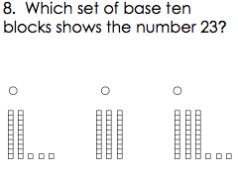
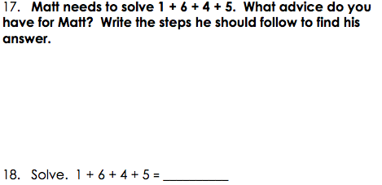
Assessments NBT

