Slide 1
Second Grade Benchmark 2 Boot Camp Class

Slide 2
Math Core Implementation
The fun Theory
Piano stairs
World’s Deepest Bin
Bottle Bank

Slide 3
Math Task – Journals
I love gardening. This year I planted pumpkins. I decided to take some data on one of my pumpkin plants and measure how much it grew. The first time I put it on the scale it weighed 1 pound. For the next five weeks my pumpkin doubled in size each week. How much does my pumpkin weigh? Show your thinking in numbers, pictures, and words.

Slide 4
Mila turned over three dot cards. There were 20 dots. The first dot card had 8 dots. How many dots did the other two cards have?
Sam says 16 + 8 = 24 and 8 + 16 = 24 are the same. Matt says they are different. Who is correct and why?
Trevor wants to add 19 + 15. What advice would you give Trevor.
How many equations can you write using 9, 8, and 17.
There are some creatures in a cave. There are 24 legs. What creatures could be in the cave?

Slide 5
Addition and Subtraction Games
•Addition and Subtraction Activities
• UEN RESOURCES
Notes:
Practice the routine with a partner

Slide 6
Numbers and Operations in Base Ten
Understand place value.
1. Understand that the three digits of a three-digit number represent amounts of hundreds, tens, and ones; e.g., 706 equals 7 hundreds, 0 tens, and 6 ones. Understand the following as special cases:
a. 100 can be thought of as a bundle of ten tens — called a “hundred.”
2. Count within 1000; skip-count by 5s, 10s, and 100s.
3. Read and write numbers to 1000 using base-ten numerals, number names, and expanded form.
4. Compare two three-digit numbers based on meanings of the hundreds, tens, and ones digits, using >, =, and < symbols to record the results of comparisons.
Use place value understanding and properties of operations to add and subtract.
5. Fluently add and subtract within 100 using strategies based on place value, properties of operations, and/or the relationship between addition and subtraction.
6. Add up to four two-digit numbers using strategies based on place value and properties of operations.
7. Add and subtract within 1000, using concrete models or drawings and strategies based on place value, properties of operations, and/or the relationship between addition and subtraction; relate the strategy to a written method. Understand that in adding or subtracting three-digit numbers, one adds or subtracts hundreds and hundreds, tens and tens, ones and ones; and sometimes it is necessary to compose or decompose tens or hundreds.
8. Mentally add 10 or 100 to a given number 100–900, and mentally subtract 10 or 100 from a given number 100–900.
9. Explain why addition and subtraction strategies work, using place value and the properties of operations.

Slide 7
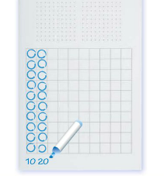
Adding tens and ones

Slide 9
Base Ten Actitivies
Roll and Record
Record and Compare (<, >, =)
Roll, record, and Combine
Roll, and write equations
Roll to 1,000 with place value dice
Tasks to generate data (nutrition cards)

Slide 10
Models for Addition
Show all Totals Groups Below Number Line

Slide 11
Math Core Benchmark 1
Measure and estimate lengths in standard units.
Measure the length of an object by selecting and using appropriate tools such as rulers, yardsticks, meter sticks, and measuring tapes.
Measure the length of an object twice, using length units of different lengths for the two measurements; describe how the two measurements relate to the size of the unit chosen.
Estimate lengths using units of inches, feet, centimeters, and meters.
Measure to determine how much longer one object is than another, expressing the length difference in terms of a standard length unit.
Work with Time and Money.
8. Solve word problems involving dollar bills, quarters, dimes, nickels, and pennies, using $ and ¢ symbols appropriately. Example: If you have 2 dimes and 3 pennies, how many cents do you have?.
Represent and interpret data.
9. Generate measurement data by measuring lengths of several objects to the nearest whole unit, or by making repeated measurements of the same object. Show the measurements by making a line plot, where the horizontal scale is marked off in whole-number units.

Slide 12
Measurement and Data
Benchmark 2

Slide 13
Math Core Benchmark 1
Operations and Algebraic Thinking
Represent and solve problems involving addition and subtraction.
Use addition and subtraction within 100 to solve one- and two-step word problems involving situations of adding to, taking from, putting together, taking apart, and comparing, with unknowns in all positions, e.g., by using drawings and equations with a symbol for the unknown number to represent the problem.
Add and subtract within 20.
2. Fluently add and subtract within 20 using mental strategies. By end of
Grade 2, know from memory all sums of two one-digit numbers.
Work with equal groups of objects to gain foundations for multiplication.
Determine whether a group of objects (up to 20) has an odd or even
number of members, e.g., by pairing objects or counting them by 2s;
write an equation to express an even number as a sum of two equal
addends.

Slide 14
Break Apart Sticks

Slide 15
Situation vs. Solution Drawings

Slide 16
Measurement and Set Models
Compare Models
Set Model Measurement
set model for subtraction
measurement model for subtraction

Slide 17
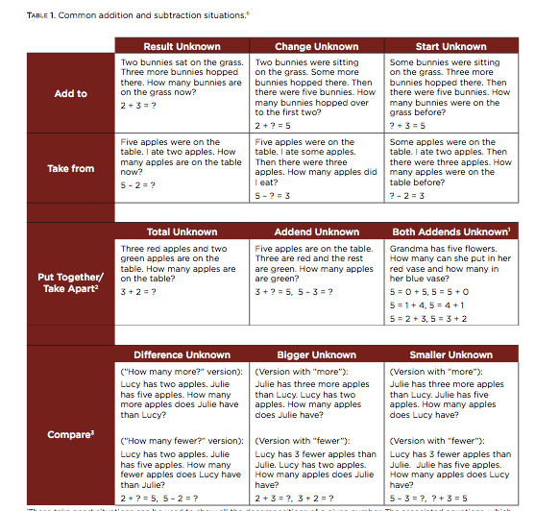
Problem Types

Slide 18
Problem Types
Add To
Take From
What is the unknown?
Change/Start/Result
Action
What is the unknown?
Change/Start/Result
Action
Put Together/Take Apart
Compare
What is the unknown?
Total/Addends/Both Addends?
No action – different parts.
What is the unknown?
Difference/Bigger/Smaller
No action – Comparison.
Notes:
Math Teen Mountain Cards, Equation Match with posters – models to represent. (Four posters and markers)

