Slide 1
DOK 1, 2, and 3
Getting the Biggest Bang from your assessments
Melissa Garber
Jordan School District Elementary Math Specialist

Slide 2
Introduction
Melissa Garber
Elementary Math Specialist for Jordan School District
We have 55 schools and about 52,000 students, about half of which are elementary students.
I can be reached at melissa.garber@jordandistrict.org

Slide 3
Snake River adventure
Notes:
I want to start today by showing off a few of my vacation slides. I’m a native Utahn and we love our outdoor adventures. This summer I met up with my brother’s family in Jackson Wyoming just South of Yellowstone and on the edge of the Grand Tetons. For part of the trip we went river rafting. Check out my cute nephew right at the front of the boat – he doesn’t even know what’s about to hit him.

Slide 4
Big Kahuna Class III rapids
Notes:
That’s right – the Big Kahuna a class III rapid. It was blast. We were soaked. Rivers are rated from class 1 – flat water to class VI – unrunnable. The biggest rapids are class V. The water on our 8 mile stretch was mostly II and III, There were 8 rapids that were significant enough to have a name.

Slide 5
Another splash
Notes:
Once again Miles didn’t realize what he was in for.

Slide 6
Someone’s missing.
Notes:
This is the point in the trip where I stopped paddling. Do you notice the big gaping hole?

Slide 7
Back in the boat
Notes:
All was fine and good. Kainoa, got back to the boat, the guide and I pulled him back in and we continued down the river ready to take on the next set of rapids. (In fact if you look closely you’ll notice that the only two people that even knew he had fallen out of the raft were the guide, “mama carnage” and me. Everyone else was engaged, doing their job, and having fun. The guide was able to concentrate on getting us through and helping the person who really needed help.) Now I’m going to contrast this experience with that of a boat we had passed earlier.

Slide 8
Scouts
Notes:
This is not the actual photo, but it is a very accurate depiction of what occurred to a scout group earlier on the float. At the put in they were jovial and laughing and having a grand time, ready to take on the river. The guides noted, that they didn’t have a river guide with them, just one of their leaders. Well you can imagine, they were doing fine on the class II portions of the river, but the first significant rapid they came upon our guide commented that they were taking an “interesting” course and sure enough, everyone got dumped out, the raft overturned and they made their way to the bank. Everyone was safe but the laughter was over and they were left figuring out how to flip their raft.

Slide 9
Depth of Knolwedge*
DOK 1: Recall (Tasks that require students to memorize, label, identify, calculate, define, name, use)
DOK 2: Skill/Concept (Tasks that require students to infer, categorize, identify patterns, construct, compare, contrast, and relate)
DOK 3: Strategic Thinking (Tasks that require students to construct, critique, justify, assess, develop a logical argument)
DOK 4: Extended Thinking (Tasks that require student to synthesize, design, prove – these generally must be done over time, think STEM or Science Fair projects. You won’t find a DOK 4 question on a standardized test.)
*Norman Webb, see also Karin Hess
Notes:
Now, I love an analogy, so I would like to compare the river to DOK levels. DOK stands for Depth of Knowledge, Norman Webb is really the pioneer in establishing these levels, Janice Hess has also done some work incorporating Webb’s DOK, with Benjamin Bloom’s taxonomy. Questions can be classified according to their cognitive demand.

Slide 10
DOK 1 vs. DOK 2 and 3
Notes:
Let’s consider the scouts. They were feeling very confident and competent. I’m assuming they have probably been successful rowing canoes, or rafts in calmer water, in fact their leader was confident enough in their abilities to take them down the Snake River known for some pretty spectacular rapids. But when faced with the real test, the application of their knowledge, they literally fell overboard.
Now our guide spent some significant time talking to us about what was going to happen, training us for what was coming up. We purposefully bounced off a large protruding rock so we could practice what to do. We weren’t afraid of making a mistake because she told us to make one and we knew how to handle it. And when Kainoa fell out, we what to do, she was there to help, and it wasn’t a big deal.
It’s safe to say that if students or scouts are only exposed to DOK 1 type activities, they gain a false sense of security. When the time comes for them to apply their understanding in a DOK 3 situation they might not be prepared. On the flip side, when teachers carefully select and prepare students for DOK 3 questions/situations and they are there to support students. Students will excel.

Slide 11
Math DOK 1 –
What is 2/3 + 3/4 ?
Your friend says 2/3 + ¾ = 5/7. Do you agree or disagree with his answer? Help convince your friend of the correctness or incorrectness of his answer.
What is the difference between the 2 questions?
Which practice standards apply?
Notes:
Let’s take a look at some examples. The difference between asking a student what is 2/3+3/4 and the difference between asking the question, your friend says 2/3 + ¾ = 5/7. Do you agree or disagree with your friends answer. Help convince your friend of the correctness or incorrectness. Is a change in DOK. The first question requires computation and nothing more. The second questions requires an analysis of the equation and a “convince me” argument. This falls into a DOK 3 level.
Robert Kaplinsky has done some excellent work on DOK levels and he shared this study. It starts out with a simple question, given the radius of the circle students must find the the circumference and the area.

Slide 12
Math DOK 1 – Robert Kaplinsky – robertkaplinsky.com
Notes:
Robert Kaplinsky has done some excellent work on DOK levels and he shared this study. It starts out with a simple question, given the radius of the circle students must find the the circumference and the area.

Slide 13
Math DOK 1 – Robert Kaplinsky
Notes:
This clip shows 10 students all ten of them answered both questions correctly. Out of 396 7th graders 68.26% answered both correctly and 78.59% answered one of the questions correctly.

Slide 14
MasteryConnect
Notes:
Pretty amazing: 7.G4 100% Mastery

Slide 15
Math DOK 2 – Robert Kaplinsky – robertkaplinsky.com
Notes:
Now let’s take a look at a DOK 2 question.

Slide 16
Math DOK 2 – Robert Kaplinsky
Notes:
This clip shows the same ten students in the first clip. As we saw on their tracker, they had already demonstrated mastery. However when the question is changed and students are asked to think about the problem in a deeper way, only 1 out of the ten students was able to answer correctly and explain the reasoning behind his answer. Out of the 396 7th graders only 12.12% answered both parts correctly.
Now of the 12% that answered those correctly, 97.9% answered both of the DOK 1 questions correctly. What does that tell us? That Students who can complete the DOK 2 questions, have mastery of DOK 1 level concepts.

Slide 17
Comparison
Notes:
This is what the tracker would look like. Using a 2 point scale, the tracker went from every student achieving mastery to only 1 student achieving mastery, 3 students needing remediation, and 6 at near mastery.

Slide 18
Word Association
Notes:
Turn to your neighbor and tell them the first thing that comes to mind when you see this. Show of hands how many of you had positive things to say? How many of you had negative comments? All of these problems are DOK1 questions. It’s pure computation. If students know how to compute they do well. They think I’m good at math. If they don’t know how to compute or do the procedure it takes them a long time, they might not finish, they get frustrated and they tell themselves they aren’t good at math. This is actually a problem for both groups of students. These problems give a false sense of what math is – math is not just speed and accuracy. These types of assignments promote a fixed mindset.

Slide 19
Fixed vs Growth Mindset
Notes:
What is our take away? Students have to be taught using DOK 2 and 3 questions. They will have a better concept of what math is – sense making and reasoning. Just like our river trip – Most of us in the boat had very little experience. From the first second we stepped in the boat we started training for the application in context and with the purpose of tackling the rapids, we learned the skills necessary to be successful when we hit those class III rapids. The scouts who I’m sure had already experienced rowing in calm water felt overly confident, they didn’t go in prepared. They assumed because they were successful, they knew what to do and it was disastrous when faced with a real challenge.
The problem with DOK 1 questions is it creates over confidence in students who know how to memorize or calculate, or recall. It also creates anxiety in students who can’t. These DOK 1 problems perpetuate a fixed mindset (Carol Dwek and Jo Bolar has a lot to say about fixed mindset versus growth mindset and the awful consequences it has had in math education)

Slide 20
Natural Problem Solvers
Notes:
Children are natural problem solvers. We must capitalize on their desire to problem solve and provide experiences that won’t mask the mastery, but will provide a true indication of their abilities. When we use DOK 2 and 3 type problems, we allow students to not only practice skills necessary for recall and computation, but they get to practice skills that engage the pituitary portion of their brain – the part that deals with approximation, analysis, and evaluation.

Slide 21
Math Practice Standard 1
Notes:
Additionally, the only way students can successfully show evidence of mastery of the Math Practice Standards, they must be asked DOK 2 and 3 questions.

Slide 22
Math Practice Standard 2

Slide 23
Math Practice Standard 3

Slide 24
DOK 1: 3.NF.2
Notes:
So let’s practice. Think about the cognitive demand for each of the following questions.

Slide 25
DOK 2: 3.NF.2

Slide 26
DOK 3: 3.NF.2

Slide 27
Sample questions
#16 – 17 (4.OA.3)
The Clayton family wants to attend the Utah State Fair. They will need to purchase 2 adult tickets at $9 each and 3 youth tickets at $7 each. The family also plans to spend $45 on food and drinks at the fair. How much will the Clayton family spend to visit the fair?
16. Write an equation to represent this situation.
17. How much will the Clayton family spend to visit the fair?

Slide 28
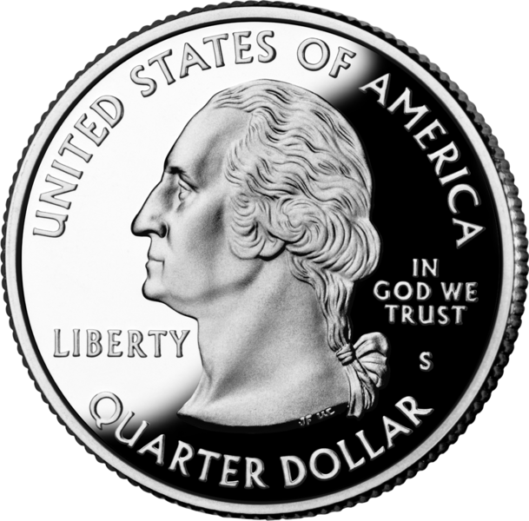
Sample questions
2.MD.8
26. Talin has 80¢. He has one quarter, some dimes, some nickels, and no pennies. How many dimes and nickels does Talin have? Draw and label the coins if needed.
Quarters 1 Dimes ______ Nickels _____ Pennies 0­

Slide 29
References
Norman Webb 2003 (DOK levels)
Janice Hess 2009 (Webb/Blooms integration)
Robert Kaplinsky (DOK videos: robertkaplinsky.com)
Jordan School District Practice Standards (avilable at elemmth.jordandistrict.org)
My Son Genius: https://www.youtube.com/watch?v=5XeXbGTt0sg

Slide 30
Enjoy the Ride!
melissa.garber@jordandistrict.org
Website: elemmath.jordandistrict.org

