Slide 1
Practice Standards
Tools and Strategies for Grades 3 – 5
Michelle Kilcrease & Tami Bird, Jordan School District

Slide 2
Purpose
Share strategies and tools for mathematics supervisors to help their teachers understand and implement the 8 Standards for Mathematical Practices

Slide 3
Background
Utah State Office of Education recommended CCSS - Math implementation for 6th & 9th Grades in 2011-2012.
As Math Teacher Specialists, we delved into the core to anticipate what PD our teachers would need.
Notes:
We also worked with committees formed by the state office, and we formed a small consortium with neighboring districts. However, the main focus of our work in those settings was to dissect and interpret the grade-level content. As Tami and I gained more experience with the content, we began to understand the underlying significance of the Practice Standards: they were the end-game that we wanted ALL students to know and be able to do by the end of 12th grade. So, our work with the Practice Standards was primarily done within our own district.

Slide 4
JSD Multi-Tiered PLC Support System
Notes:
This is our curriculum model. It is the center of our work. Everything we do to help our teachers is grounded in this model. It encompasses how we, as a district, work as Professional Learning Communities and use Response to Intervention in our endeavors to help our students learn academics and behaviors.

Slide 5
Essential PLC Questions
What do we want our teachers to know and be able to do?
How will we know if they know it and/or can do it?
What will we do if they don’t know it and/or can’t do it?
What will we do if they do know it and/or can do it?
Notes:
As a curriculum PLC, our ‘students’ are our teachers. We substitute ‘students’ for ‘teachers’ as we plan professional development. We are only in the first phase of implementation, so right now our focus is solely on question number one.

Slide 6
What do we want our teachers to know and be able to do?
Understand the philosophical and pedagogical changes of the core.
Understand the mathematics of the Content Standards.
Understand and implement the Practice Standards in mathematics instruction.
Access provided resources.
Notes:
We understood

Slide 7
What do we want our teachers to know and be able to do?
Understand the philosophical and pedagogical changes of the core.
Understand the mathematics of the Content Standards.
Understand and implement the Practice Standards in mathematics instruction.
Access resources we had provided.
Notes:
We understood and had tools for everything except the Practice Standards. They were similar to the ILO’s in our state core. As specialists, we knew and understood the NCTM process standards and the Strands of Mathematical Proficiency. If the Practice Standards rested upon these longstanding and important processes and proficiencies, we were in good shape, right? In fact, in some of our State Office meetings, our state math specialists started engaging us in compare/contrast activities. These activities initiated taking prior knowledge (NCTM & Proficiency Strands) and connecting it to new knowledge, the CCSSM Practice Standards. These activities are on-line and available for download.

Slide 8
Differentiation strategies for unpacking and understanding the Practice Standards
Working with math leaders (state, district office, coaches)
Working with teachers
Working with administrators (district & building level)
Working with community

Slide 9
Strategies: Math Leaders
USOE
Compare/Contrast: Standards for Mathematical Practice with NCTM and Utah’s current core ILO’s

Slide 10
USOE Activity #2
Bring copies of NCTM’s Principles and Standards for School Mathematics and the Utah 2007 Core. Discuss the following:
Which NCTM Process Standard(s) suggests the same processes and proficiencies as the Common Core Standards for Mathematical Practices?

Slide 11
Activity #3

Slide 12
Strategies: Coaches
What does it look like?
What does it sound like?
How can we convey these ideas to students & teachers?
Notes:
At our state meetings, it was easier to deeply dive into the practice standards because we had existing prior knowledge and understanding of the building blocks from which they were created. As district math specialists, we also had time ~ and quite frankly in many cases, the interest, in probing and comprehending them. However, the reality is that our audience is comprised of elementary teachers and principals that come from varying backgrounds. While it was great to meet at a state level with math educator specialists, our primary target audience would not be able to jump in with most of the activities they provided. Tami and I next met with our three math coaches. Our goal was to just sit down and unpack each practice standard to make it more accessible for our teachers.

Slide 13
Connecting to Prior Knowledge
Literacy
Math
Predict
Summarize
Main Idea
Details
Structure
Inference
ETC….
What would a
math poster look
like?
Notes:
In my head, I remembered being in the classroom. I appreciated some literacy posters that our literacy specialists created to help us teachers – and the students!, remember essential reading skills like predicting, summarizing, identifying main idea and details… As I remembered these things, the vision of having Practice Standards posters became horribly important. Our work became singularly focused on the task of unpacking the standard and making it comprehensible for students. The process was pretty simple: read the standard, figure out what it looks like and sounds like, and create a visual aide to help students and teachers access it.

Slide 14
SMP #2 Construct viable arguments and critique the reasoning of others.
Mathematically proficient students make sense of quantities and their relationships in problem situations. They bring two complementary abilities to bear on problems involving quantitative relationships: the ability to decontextualize – to abstract a given situation and represent it symbolically and manipulate the representing symbols as if they have a life of their own, without necessarily attending to their referents – and the ability to contextualize, to pause as needed during the manipulation process in order to probe into the referents for the symbols involved. Quantitative reasoning entails habits of creating a coherent representation of the problem at hand; considering the units involved; attending to the meaning of quantities, not just how to compute them; and knowing and flexibly using different properties of operations and such.

Slide 15
SMP #2 Construct viable arguments and critique the reasoning of others.
Mathematically proficient students make sense of quantities and their relationships in problem situations. They bring two complementary abilities to bear on problems involving quantitative relationships: the ability to decontextualize – to abstract a given situation and represent it symbolically and manipulate the representing symbols as if they have a life of their own, without necessarily attending to their referents – and the ability to contextualize, to pause as needed during the manipulation process in order to probe into the referents for the symbols involved. Quantitative reasoning entails habits of creating a coherent representation of the problem at hand; considering the units involved; attending to the meaning of quantities, not just how to compute them; and knowing and flexibly using different properties of operations and such.

Slide 16
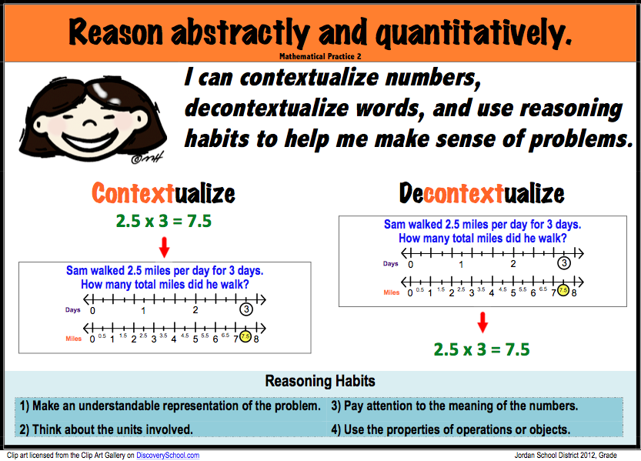
Notes:
This poster captures the essential ideas of Practice Standard #2. It gives teachers and students an “I can…” statement which enables them to articulate what they need to be able to do. It gives explanations and examples of what each essential idea means. It is an instructional tool that assist teachers and students.

Slide 17
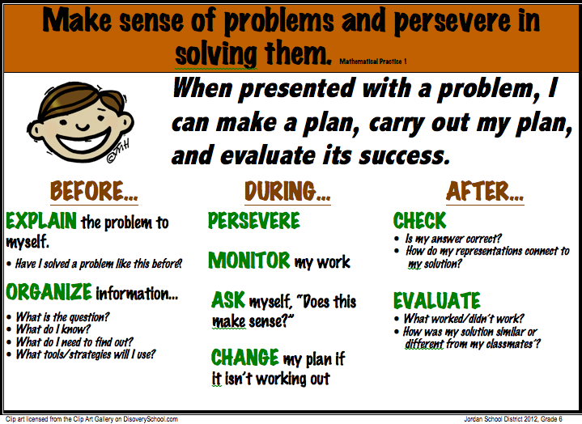

Slide 18
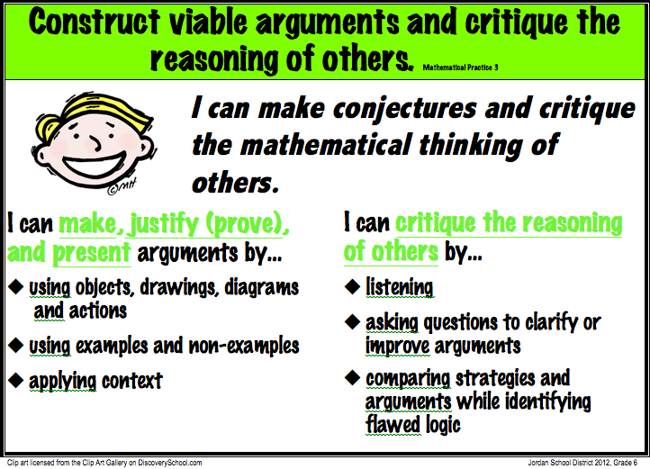

Slide 19
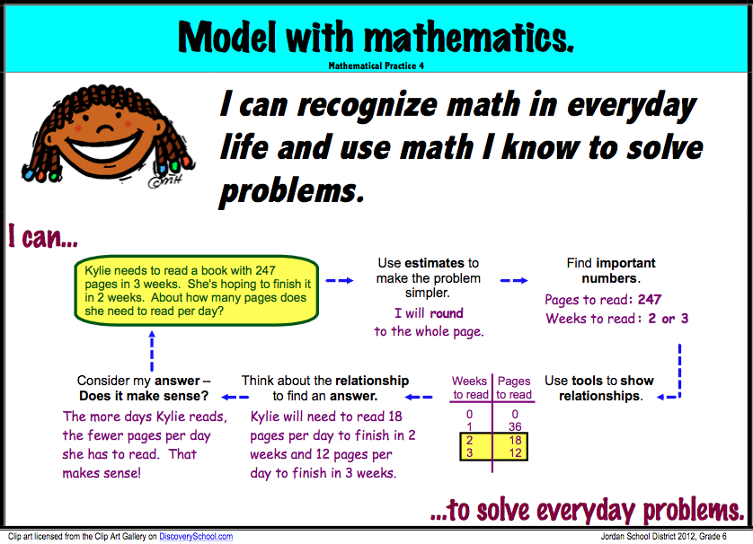

Slide 20
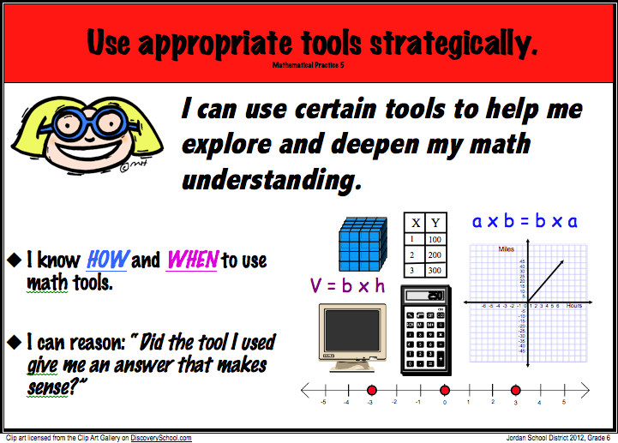

Slide 21
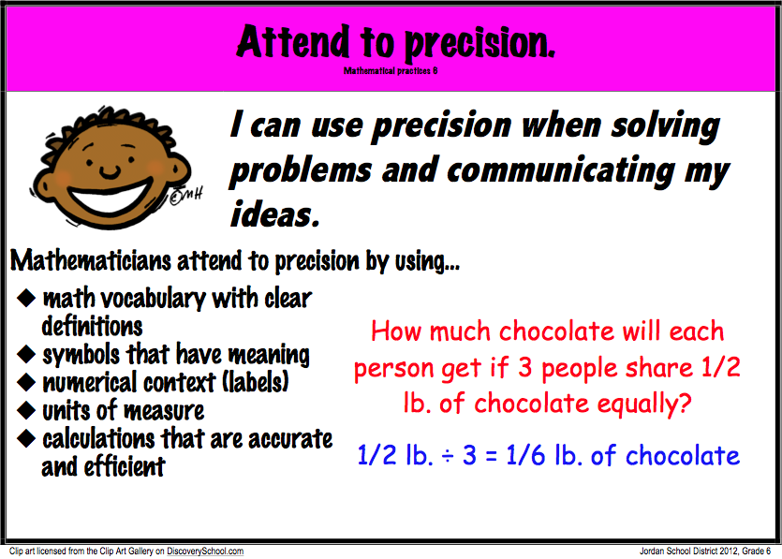

Slide 22
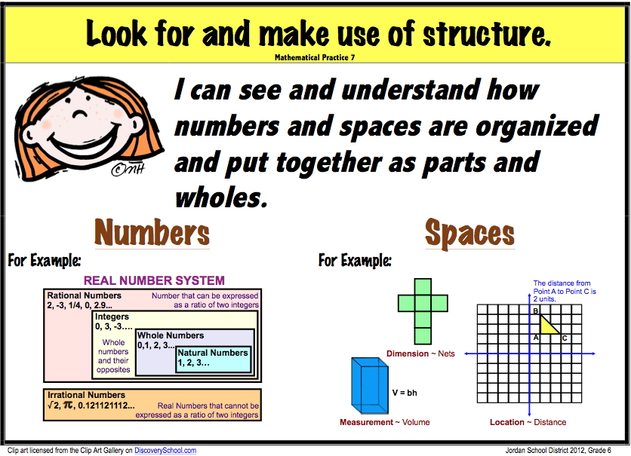

Slide 23
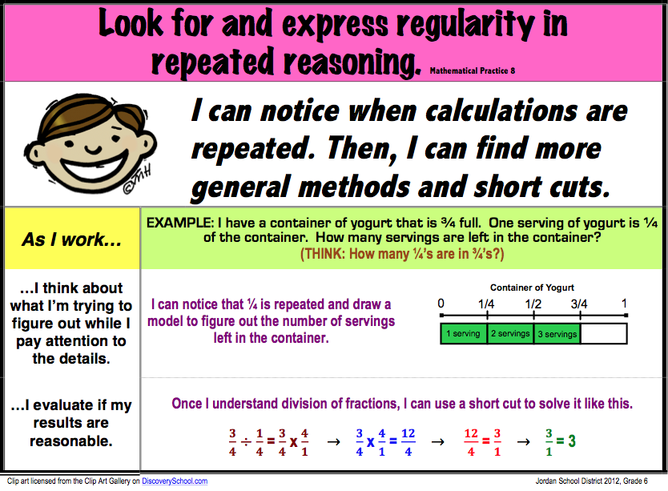

Slide 24
Strategies: Teacher Leaders
The next group of people with whom we worked were our teacher writing teams. Each team consisted of 3 – 5 classroom teachers with varying levels of pedagogical content knowledge and with varying levels of mathematics content knowledge.

Slide 25
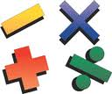
Changing our view of how to access the practice standards with teachers.
Initial “unpacking” of the Content Standards is a prerequisite for understanding the Practices Standards.
Notes:
We’ve come to understand how interrelated the practice and content standards are.
Our initial thinking was to introduce the practice standards as a segway into the content standards.
Our current thinking is that the content standards provide

Slide 26
Understanding Mathematics
CONCEPTUAL UNDERSTANDING:
  What a student needs to KNOW
PROCEDURAL UNDERSTANDING:
  What a student needs to be able to DO
REPRESENTATIONAL UNDERSTANDING:
  How a student SHOWS what he/she
  knows or can do.
Notes:
We have created an instructional framework for teaching mathematics with our university partner, Brigham Young University. Student proficiency within three domains are required for understanding mathematics has emerged from that work. We are using those domains to help our teachers unpack the content standards in the core. Let’s review those domains. The Conceptual Understanding domain addresses what students need to know about mathematics. The procedural addresses what students need to be able to do mathematically. Finally, the representational domain addresses how student show what they know or can do.

Slide 27
Applying CPR to the
Common Core
PLC Activity
Work in teams to examine the 3rd grade core.
Highlight and color code phrases in the standards as emphasizing conceptual (KNOW), procedural (DO), or representational (SHOW) understanding.
Underline the verbs – it will often help you determine what type of understanding is expected.
Notes:
This is the activity that we’ve been using with our teachers prior to exposing them to the practice standards. Just to give you a flavor of what this does, we’ll go through a few standards together.

Slide 28
Applying CPR to the
Common Core – 3.NF
3. Explain equivalence of fractions in special cases, and compare fractions by reasoning about their size.
a. Understand two fractions as equivalent (equal) if they are the
same size, or the same point on a number line.
a. Understand two fractions as equivalent (equal) if they are the
same size, or the same point on a number line.
CONCEPTUAL PROCEDURAL REPRESENTATIONAL
Notes:
This is the activity that we’ve been using with our teachers prior to exposing them to the practice standards. Just to give you a flavor of what this does, we’ll go through a few standards together.

Slide 29
Applying CPR to the
Common Core – 3.NF
3. Explain equivalence of fractions in special cases, and compare fractions by reasoning about their size.
b. Recognize and generate simple equivalent fractions, e.g., 1/2 =
2/4, 4/6 = 2/3). Explain why the fractions are equivalent, e.g., by
using a visual fraction model.
b. Recognize and generate simple equivalent fractions, e.g., 1/2 =
2/4, 4/6 = 2/3). Explain why the fractions are equivalent, e.g., by
using a visual fraction model.
CONCEPTUAL PROCEDURAL REPRESENTATIONAL
Notes:
This is the activity that we’ve been using with our teachers prior to exposing them to the practice standards. Just to give you a flavor of what this does, we’ll go through a few standards together.

Slide 30
Applying CPR to the
Common Core – 3.NF
3. Explain equivalence of fractions in special cases, and compare fractions by reasoning about their size.
c. Express whole numbers as fractions, and recognize fractions that
are equivalent to whole numbers. Examples: Express 3 in the form
3 = 3/1; recognize that 6/1 = 6; locate 4/4 and 1 at the same point
of a number line diagram.
c. Express whole numbers as fractions, and recognize fractions that
are equivalent to whole numbers. Examples: Express 3 in the form
3 = 3/1; recognize that 6/1 = 6; locate 4/4 and 1 at the same point
of a number line diagram.
CONCEPTUAL PROCEDURAL REPRESENTATIONAL
Notes:
This is the activity that we’ve been using with our teachers prior to exposing them to the practice standards. Just to give you a flavor of what this does, we’ll go through a few standards together.

Slide 31
Applying CPR to the
Common Core – 3.NF
3. Explain equivalence of fractions in special cases, and compare fractions by reasoning about their size.
d. Compare two fractions with the same numerator or the same
denominator by reasoning about their size. Recognize that
comparisons are valid only when the two fractions refer to the
same whole. Record the results of comparisons with the symbols
>, =, or <, and justify the conclusions, e.g., by using a visual
fraction model.
d. Compare two fractions with the same numerator or the same
denominator by reasoning about their size. Recognize that
comparisons are valid only when the two fractions refer to the
same whole. Record the results of comparisons with the symbols
>, =, or <, and justify the conclusions, e.g., by using a visual
fraction model.
CONCEPTUAL PROCEDURAL REPRESENTATIONAL
Notes:
This is the activity that we’ve been using with our teachers prior to exposing them to the practice standards. Just to give you a flavor of what this does, we’ll go through a few standards together.

Slide 32
A CPR view of a core cluster
3. Explain equivalence of fractions in special cases, and compare fractions by reasoning about their size.
a. Understand two fractions as equivalent (equal) if they are the same size, or the same point on a number line.
b. Recognize and generate simple equivalent fractions, e.g., 1/2 = 2/4, 4/6 =
2/3). Explain why the fractions are equivalent, e.g., by using a visual fraction model.
c. Express whole numbers as fractions, and recognize fractions that are equivalent to whole numbers. Examples: Express 3 in the form 3 = 3/1; recognize that 6/1 = 6; locate 4/4 and 1 at the same point of a number line diagram.
d. Compare two fractions with the same numerator or the same denominator by reasoning about their size. Recognize that comparisons are valid only when the two fractions refer to the same whole. Record the results of comparisons with the symbols >, =, or <, and justify the conclusions, e.g., by using a visual fraction model.

Slide 33
Guiding Question leading to practice standards discussion:
What are the implications for teaching and learning based on the CPR review?
Students and teachers will need a different type of learning experience than they’ve had in the past.
  Content Support
  Practices Support
Notes:
Content support is available both on the market and housed in our knowledge in the district.
We needed to develop a tool that would help students and teachers develop the expertise for the practices…thus, the posters.

Slide 34
Building practice standard understanding from CPR
K-5 Writing Teacher Teams
Used CPR activity
Used 6th grade practice posters to generate discussion for K-5 posters
Collaboration resulted in K-1st, 2-3rd, 4-5th, and revised 6th grade posters
Notes:
1- OUR CURRENT WORK WITH THE WRITING TEAMS…..used CPR to help create grade band posters.

Slide 35
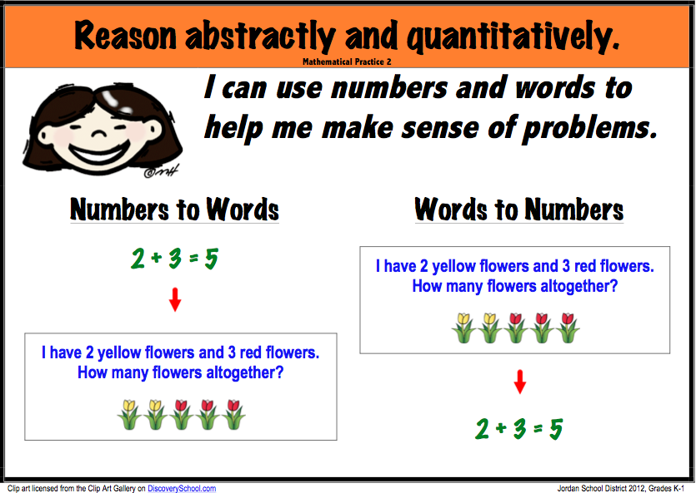

Slide 36
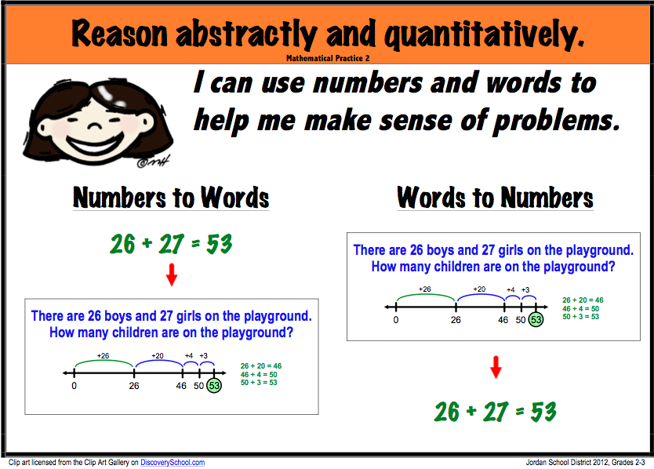

Slide 37
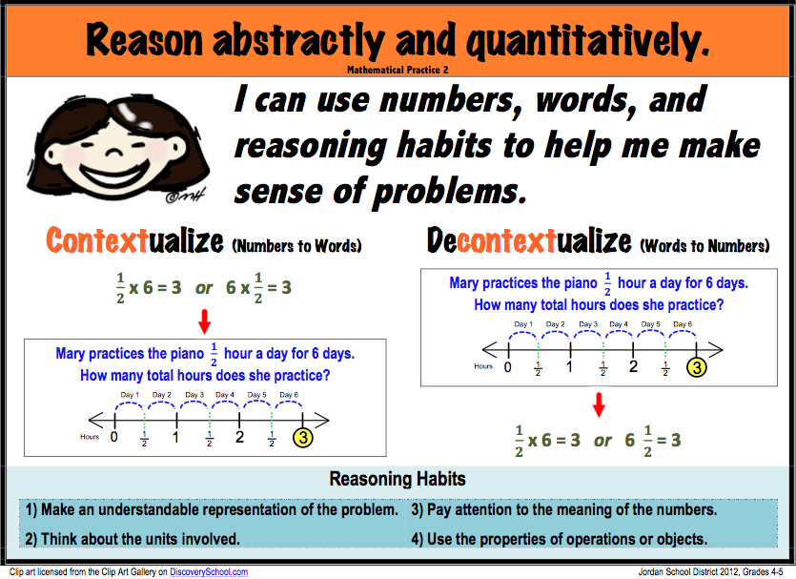

Slide 39
Upcoming work with K-5 teachers
1 - CPR Activity with content standard(s)
2 - Review a practice standard and corresponding posters. Discuss….
  Correlations between the posters and the actual standards
  Evidence of concepts, procedures, and representations
  Implementation ideas – classroom use
Notes:
Future work with May professional development

Slide 40
Other tools in progress to help our audiences find entry points for engaging in the Standards for Mathematical Practices…
Conceptual Foundations (teachers)
Principal Observation Guides (can be used by teachers during lesson study, too!)
Parent Guides (community, Board members)

Slide 41
Notes:
This is just ONE of five pages that we created to help our teachers better access the content. This particular page helps teachers understand and use the language of the core – specifically in terms of representing ratios using models. This relates directly to a student being able to engage in several of the practice standards (modeling, contextualizing, solving).

Slide 43
In the end…
Strategies for helping other math leaders and elementary teachers and principals understand the Standards for Mathematical Practices

Slide 44
Contact Information
http://www.jordandistrict.org
** access through the curriculum department, elementary mathematics
tami.bird@jordandistrict.org
michelle.kilcrease@jordandistrict.org

