Slide 1

Using the Operation Posters in Your Classroom

Slide 2
Why use the operation posters in my classroom or school?
Help students develop a common definition for the operations.
Help students develop a conceptual understanding of the operations.
Help students make connections between inverse operations.
Help students and teachers establish the types of models that can be used as representations.
Provide clarity about the structure of the operation equations.

Slide 3
How might I use the posters.
When it’s appropriate in the curriculum.
  Students can still access the ideas on the posters even if they’re working with a different class of numbers (e.g. fractions instead of whole numbers).
When moving from different classes of numbers, use the operations posters to help the students see that “addition is still addition” even if they’re working with different kinds of numbers.
NOTE: The classes of numbers students work with in elementary school are on the next slide. ☺

Slide 4
Classes of Numbers students work with in elementary grades

Slide 5
Highlights of the
Addition Poster
Addition is defined as “joining of like things”
  We can join quantities in any of the classes of numbers. For example,
    WHOLE NUMBERS: 19 + 3 = (9 + 3) + 10
      9 + 3 = 12 The 10 is “not a like thing” when it’s in the ones column, so it has to be regrouped to the tens column. Then the remaining 10 can be combined with the new ten to make 22.
    FRACTIONS: 1/4 + 2/3
      Convert to twelfths because these fractions have to be “like things”

Slide 6
Highlights of the
Addition Poster
Set Model: Set models are made of discrete objects like tally marks or blocks.
Measurement Model: Measurement models are more continuous in nature (vs. a tally mark or block in a set model) and are most often a number line. For example, the space between two numbers can be divided into an infinite amount of other numbers. In this number line, you can see that the space between 0 and 1 has been divided in half.

Slide 7
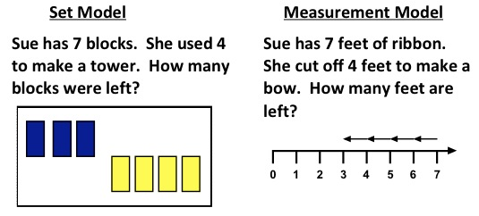
Highlights of the
Subtraction Poster: Types of Subtraction
TAKE AWAY
Defined as “removing a part”
Models: Set and Measurement

Slide 8
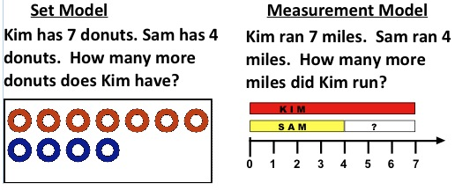
Highlights of the
Subtraction Poster: Types of Subtraction
Comparison
Defined as “comparing to find the difference”
Models: Set and Measurement

Slide 9
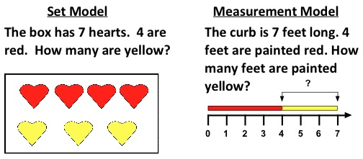
Highlights of the
Subtraction Poster: Types of Subtraction
Part - Whole
Defined as “find the missing part”
Models: Set and Measurement

Slide 10
Relationship Between Addition & Subtraction Equations
Addition: Part + Part = Whole
Subtraction: Whole – Part = Part
Help students see the structure of the equation!

Slide 11
Highlights of the Multiplication Poster
Multiplication is repeated addition of same-sized groups.
  Generally the first factor in a multiplication expression tells the # of groups and the second factor tells the size of the group.
    WHOLE NUMBERS: 2 x 5 = 2 groups with 5 items per group = 10 items
    FRACTIONS: 3 x ¼ or 3 groups of ¼ , which is ¼ + ¼ + ¼
      (3 tells the # of group and ¼ tells the size of the group) Because of the commutative property of Multiplication, we can also think about this as ¼ (# of groups) x 3 (size of the group) =3/4 total item.

Slide 12

Models for Multiplication
SET MODEL
This is still a group of discrete objects and will most likely look like sorting. If I have 2 groups of 4 candies per group, there are 8 candies in all.

Slide 13
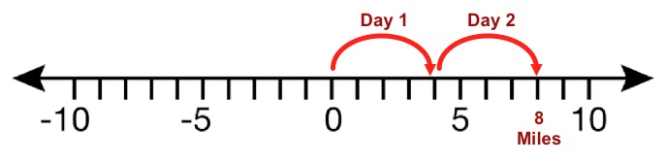
Models for Multiplication
MEASUREMENT MODEL
The number of groups: Represented as hops on a number line.
Size of the group: Represented as the counted spaces in a group.
Total Items: Counted spaces in all.

Slide 14
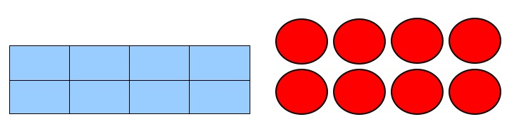
Models for Multiplication
ARRAY MODEL
This introduces a 2-dimensional model. One side represents the number of groups (typically rows) and another side represents the number of items in a group (typically columns).

Slide 15
Multiplication Equation Structure
Number of Groups x Size of the Groups = Total Items Per Group

Slide 16
Division
Division can be defined as separating the whole to determine the size of each group or the number of groups.
Reflect back to the role of the factors in multiplication. One fact represents the size of the group and the other factor represents the number of groups. The role of the factor is carries over into thinking about the two types of division.

Slide 17
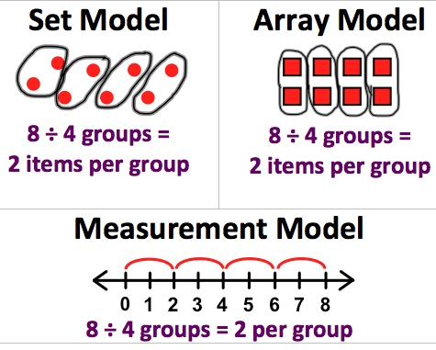
Types for Division
Partitive Division
KNOWN: Number of groups
FINDING: Size of groups
Imagine taking 8 cupcakes and fair sharing them onto 4 plates. After all cupcakes are shared equally, there will be 2 cupcakes on each plate. How does that match the images on the right? Can you “see” the plates and cupcakes in the drawings?

Slide 18
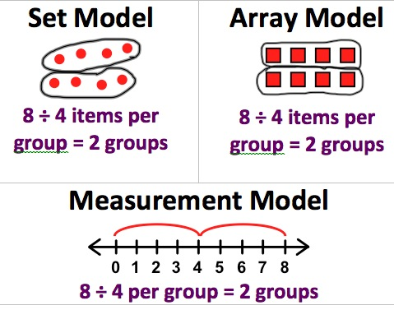
Types for Division
Quotative Division
KNOWN: Size of the groups
FINDING: Number of groups
Imagine cutting an 8 inch licorice rope into 4 inch sections. There would be 2 sections. How does that match the images on the right? Can you “see” the licorice cut into sections?

Slide 19
Division Equation Structure
PARTITIVE DIVISION
Total items ÷ number of groups = size of the group
QUOTATIVE DIVISION
Total items ÷ size of the group = number of groups

Slide 20
Relationship between Multiplication & Division
Multiplication begins with parts in the form of factors and ends with a total number of items.
Division begins with the total number of items and ends with the size of the group or number of groups.

Slide 21
The Operations as a Bridge for Understanding Math
As students begin to understand the consistency of the operations, there is greater potential for developing mathematical understanding as a web of related ideas.
Support for using the posters in your school:
  Contact JSD Math Department at 801-567-8170 or 801-567-8132.

