Slide 1
Elementary Math Core Training
Principals – March 19

Slide 2
Agenda
Grade Level Focus and Gaps
HMH RTI Resources
JSD RTI Resources
Teacher Expectations for 2013-2014
JSD Curriculum
Ordering For Next Year
Notes:
Bruce

Slide 3
Gaps in Content – Grade Level Focus
  K-2: Addition, Subtraction, Place Value (Depth)
  3rd: Multiplication and Division Facts, Intro to Fractions (Depth)
  4th: Multiplication and Division Whole Numbers, Fractions, (Depth)
  5th: Operations with Fractions and Decimals, Expressions, (Depth)
  6th: Ratios and Proportions, Expressions and Equations, (Depth)
  Problem Solving is a major focus in every grade level.
  Geometry and Measurement
Notes:
Bruce

Slide 4
Fractions -- RTI
What resources are available for teachers to use when implementing and planning student interventions.
Notes:
Melissa

Slide 5
HMH Resources for RTI – Task Cards
Notes:
Melissa

Slide 6
HMH Resources for RTI – Task Cards
Notes:
Melissa

Slide 7
HMH Resources for RTI – Challenge
Notes:
Melissa

Slide 8
HMH Resources for RTI – Worksheets
Notes:
Melissa

Slide 9
HMH Resources for RTI – Worksheets
Notes:
Melissa

Slide 10
HMH Resources for RTI – Worksheets
Notes:
Melissa

Slide 11
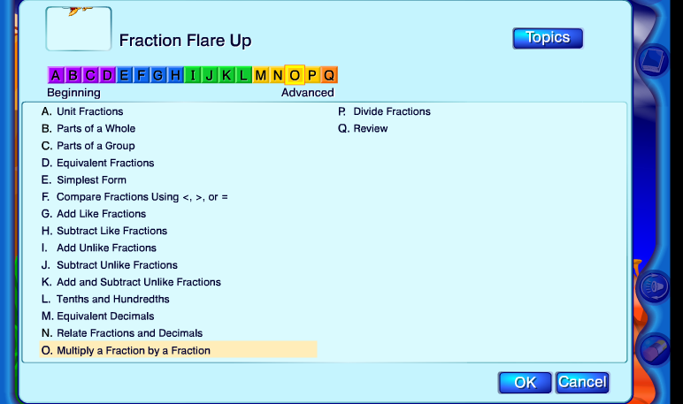
HMH Resources for RTI – Online Games
Notes:
Melissa

Slide 12
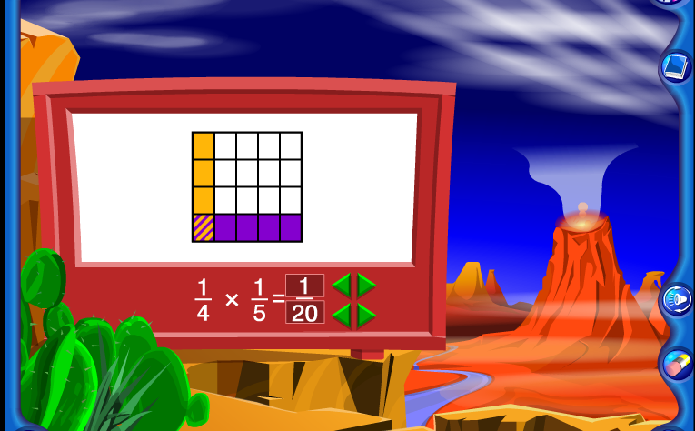
HMH Resources for RTI – Online Games
Notes:
Melissa

Slide 13
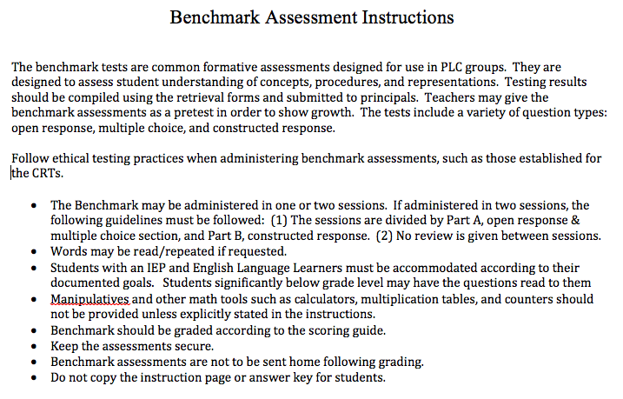
JSD Resources for RTI: Benchmarks
Notes:
Bruce

Slide 14
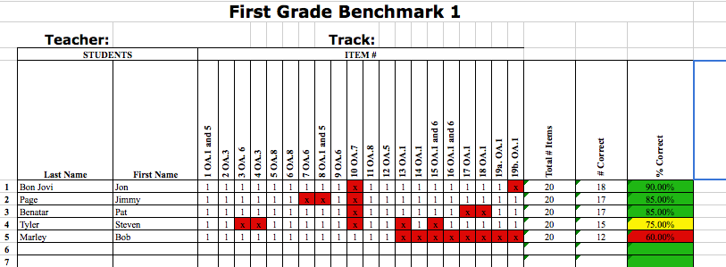
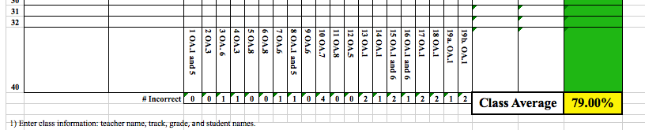
Benchmark Retrievals
Notes:
Bruce

Slide 15
Website: elemmath.jordandistrict.org
  Teaching Strategy Videos
  UEN
  CCSSM Links
  LearnZillion
Notes:
Bruce

Slide 16
Teacher Expectations for 2013-2014
First Priority -- Student Learning
Legal Priority -- Core
Resource Priority – HMH Models, Vocabulary, Research and Background
Follow the JSD Scope and Sequence
Give Benchmark Tests
Use Information in PLC to drive instruction
Target and Reteach essential (critical areas) during RTI time.
Give appropriate homework
Notes:
Melissa

Slide 17
JSD Curriculum
Revised Scope and Sequence
Revised Benchmarks
Firm Deadlines
Textbook Core Alignment
Essential Elements
Conceptual Foundations
Notes:
Bruce

Slide 18
Orders for Next Year
K-2 Consumables
Extra Books
Manipulatives
Additional Resources
Notes:
Melissa

